Slide 1
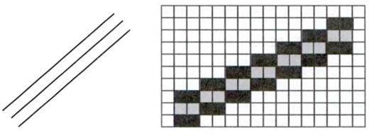
Thick lines
A line with any width w, can be generated just by putting a vertical span of w/2 pixel on both sides of the central lines as shown in the figure 1
FIGURE 1
STRUCTURE OF A THICK LINE

Slide 2

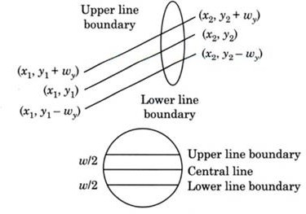
Thick lines
FIGURE 2 THICK LINE

Slide 3


Thick line
From the figure 2 the coordinates of end points of the upper and lower line boundries are (x₁,y₁+w_{y})(x₂,y₂+w_{y}) and (x₁,y₁-w_{y})(x₂,y₂-w_{y})respectively.
The value of w_{y} is as given below
The value of w_{x} is as given below
Q2 why w-1 is taken instead of w in the above two equation?

Slide 4
Thick line program
#include<iostream.h> #include<conio.h> #include<graphics.h> #include<math.h> void main()
{
int gd = DETECT, gm ;
float wy, wx, x1, y1, x2, y2;
int i, thickness;
initgraph(&gd, &gm, "C:\\Turboc3\\BGI"); cout<<"Enter the co-ordinates for the line:\n"; cout<<"X1: ";
cin>>x1; cout<<"Y1: "; cin>>y1; cout<<"X2: "; cin>>x2; cout<<"Y2: "; cin>>y2;
cout<<"Enter the required thickness: "; cin>>thickness;
cleardevice();

Slide 5
Thick line program
line (x1, y1, x2, y2);
if ((y2 - y1) / (x2 - x1) < 1)
{
wy = (thickness-1)*sqrt(pow((x2-x1),2)+pow((y2-y1),2))/(2*fabs(x2-x1)); for(i = 0; i < wy; i++)
{
line(x1, y1 - i, x2, y2 - i);
line(x1, y1 + i, x2, y2 + i);
}
}
else
{
wx = (thickness-1)*sqrt(pow((x2-x1),2)+pow((y2-y1),2))/(2*fabs(y2-y1)); for(i = 0; i < wx; i++)
{
line(x1 - i, y1, x2 - i, y2); line(x1 + i, y1, x2 + i, y2);
}
}
cout<<"This is the line of thickness" <<thickness <<"units.\n"; getch();
closegraph()
}

Slide 6
Thick line program
Q 3 What is display by the below line function.
line (x1, y1, x2, y2);
Write the answer in the question box.

